Slide 1
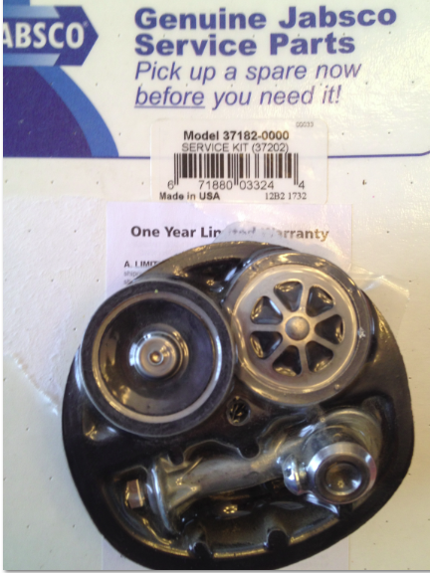
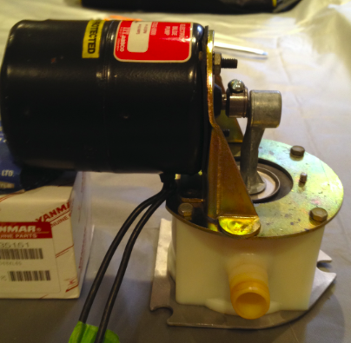
Bilge Pump Service Project
Model 37202-0000
Service Kit 37182-0000
Boat: 1997 Catalina 320
PAR Electric Bilge Pump
12 volt DC
4.5 GPM
8.0 Amps
Prepared by:
Ted Harrison

Slide 2
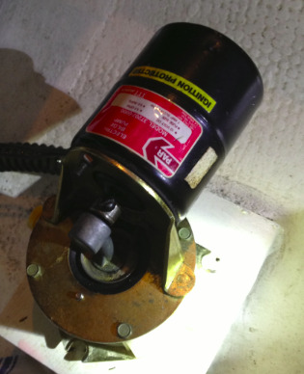
History:
Just before haul out the bilge pump stopped working. I removed the intake line from the pump. There was little suction from the pump
It was becoming very loud / noisy before it failed
The pump is located in the port lazarette
It sits on a level wood frame. The suction line runs from the pump into the bilge

Slide 3
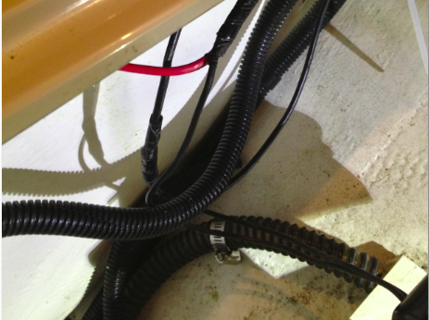
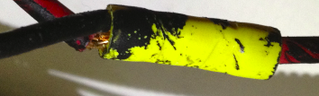
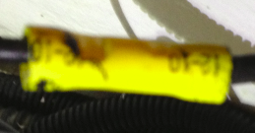
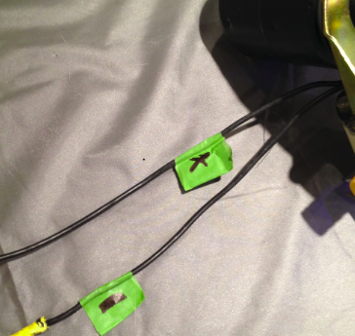
Followed the wires from the pump to their connect points.
Safety always comes first
- Label and take pictures, you will notice that I have labelled the black wires from the pump to their connection points.
- If you do not know / or are not sure about the power ask for help or assistance from a professional
- Before I started the project I turned off the power and tested the wires for power with a volt meter
-The picture shows the positive and negative wires. Normally red for positive and black for negative. You most always check because you never know who has completed wiring on the boat.
Positive Connect
Negative Connect
Pump wires Labelled

Slide 4
Remove the pump
Disconnect the output line (discharge)
Removed the three screws the hold the pump in place
I place the screws in a zip plastic bag, and label the bag
In this picture the screws have been removed

Slide 5
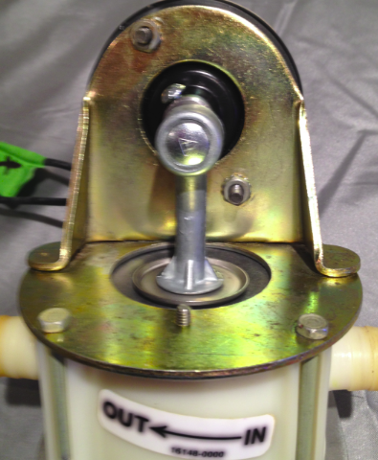
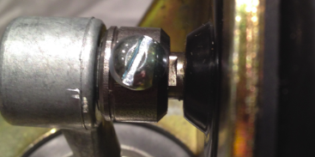
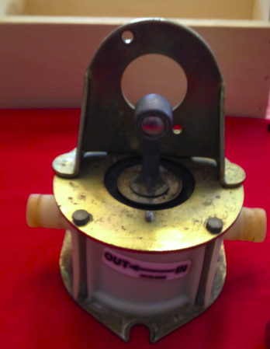
Objective: Replace inlet value, outlet value, and pulsation dampener
Set Screw
Motor shaft – flat edge
Nuts
Remove the Motor from Motor Mount
I set the pump motor on the side of my son’s tool box to support the unit (so it is level)
Loosen the set / lock screw on top of the connecting rob with a flat screw driver. Notice the flat side or edge on the motor shaft
Remove the two 3/8 nuts that hold motor to the motor mount
The bottom picture is with the motor removed
Connecting Rod
Motor Mount
Bolt that holds the mount to the base (there are four)
Base

Slide 6
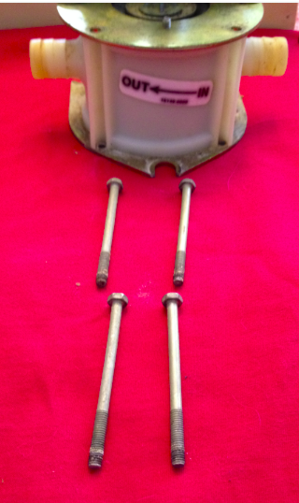
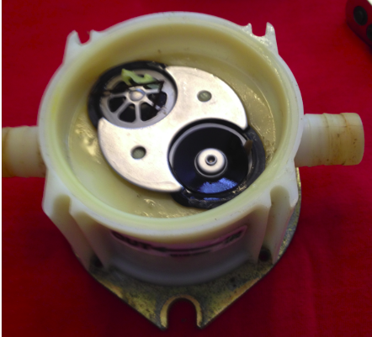
Remove base from motor mount
Remove the 4 bolts, with a 5/16 inch wrench, they hold the base in place
Two bolts are under the motor on the back side, not shown in the picture. Notice the bolts run on the outside of the base and into the bottom plate
Play attention to the orientation of the base and in general all parts. The intake is on the right and output or discharge is on the left
This is important so that you place the valves correctly as shown in this diagram
Discharge Value
Intake Value
Value retainer plate

Slide 7
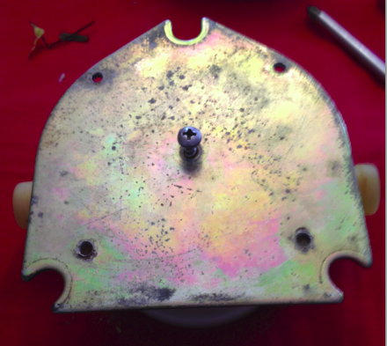
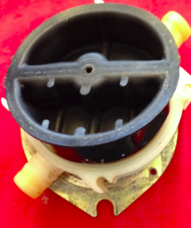
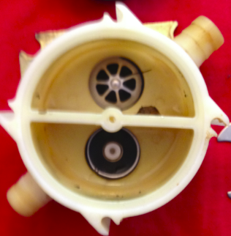
Parts Removed
One screw remains holding the bottom plate to the base
Pay attention to the three ribs on the discharge side of the pulsation dampener and the single rib on the intake side
The Pulsation Dampener just pulls out
The valve retaining plate and valves just lift out or you can just push them out from the under side
Philips Screw
Bottom Plate
One rib
Pulsation Dampener
Three ribs
Base with Pulsation Dampener removed

Slide 8
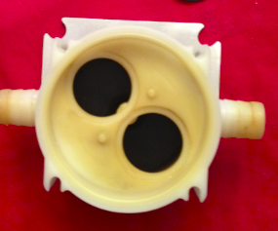
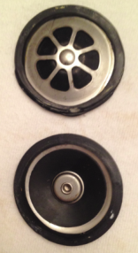
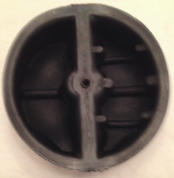
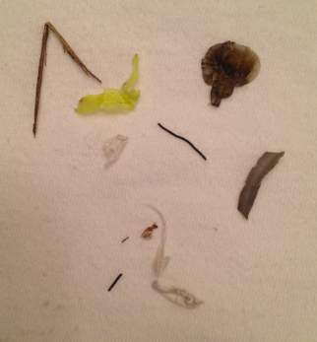
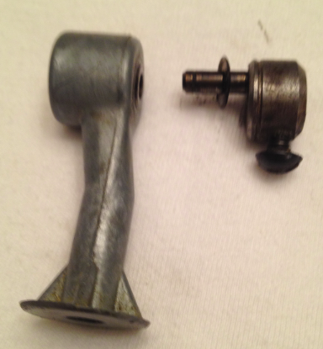
Clean all parts
I cleaned and examined all the parts
I used dish soap and hot water and in some cases Vim to remove grease
I used a brass wire bush to clean nuts, buts, and plates. The wire bush actually removed the brass finish on the plates!
One picture shows the particles that I found in the pump
The pulsation dampener was not collapsed and did not appear ruptured, it is now a spare part
The valves looked in rough shape and replaced. The inlet and outlet values are identical, rubber flapper is up on the intake side and down for the output / discharge side
The connecting Rod was worn out
Rubber flapper
Debris found in unit
Broken Connecting Rod, no wonder the unit was noisy

Slide 9
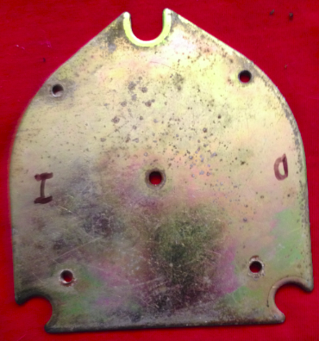
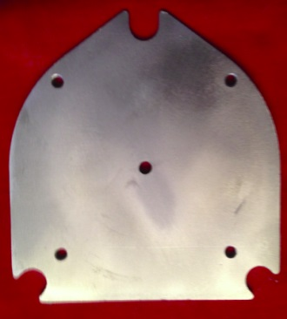
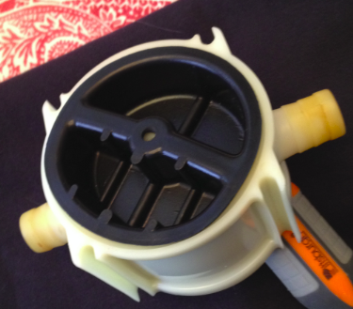
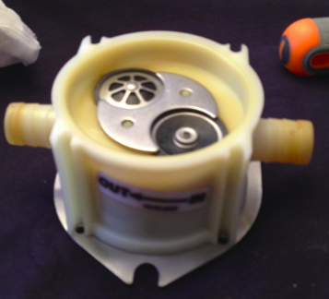
Parts are assembled
Pulsation Dampener pushed in place
Valves just sit in place, inlet rubber flapper up, outlet rubber flapper down
Valve retaining plate sits between the valves, two plastic dimples hold it in place
I attached the four bolts on the base and bottom plate before I tightened the bottom screw onto the base. This insures the alignment is correct

Slide 10
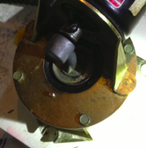
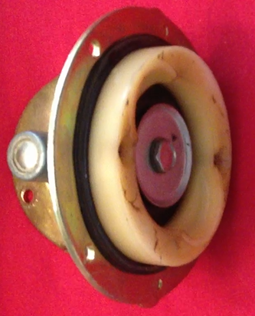
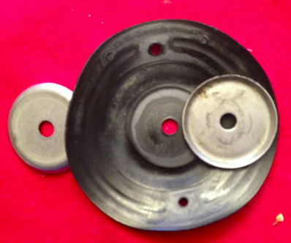
Objective: Replace diaphragm and connection rod
Replacing the Diaphragm
The Diaphragm is connected to the Connecting Rod by a bolt and a plastic Retainer by two Philips screws
Remove the bolt and screws
Peel the two Diaphragm Plates from the diaphragm. Notice the orientation. The smooth side go against the Diaphragm
Top view of the diaphragm
Black is the diaphragm
Diaphragm retainer
Bolt through the diaphragm and to the connecting Rod
Diaphragm removed
Diaphragm Plates
Orientation – smooth side

Slide 11
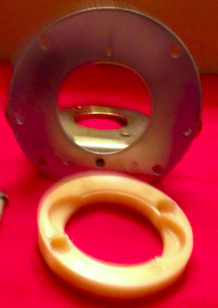
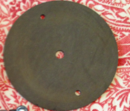
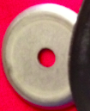
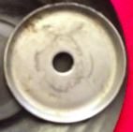

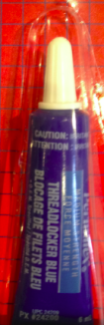
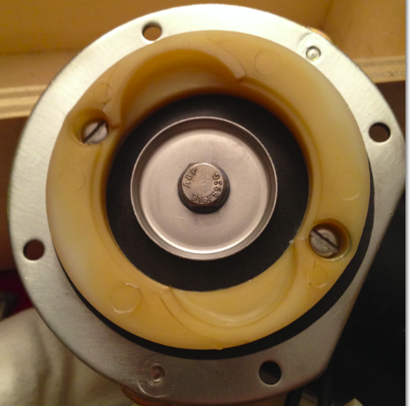
Parts are Cleaned and ready to re-assemble
Make sure you have the parts in the right orientation, for correct and quick assembly
Place the Diaphragm Plates on the new Diaphragm and push the bolt through the center hole.
I place a small drop of “blue” Thread locker on the bolt, attach to the connecting rod, very loose at this time
Attach the Diaphragm to the Retainer and onto the Motor Mount. Place a small amount of Thread locker on the screws
Tighten screws in equal turns until tight,
Tighten the Connecting Rod bolt
Motor mount
Retainer
Diaphragm
Diaphragm Plates
Connecting rod
Thread locker
Resembled unit

Slide 12
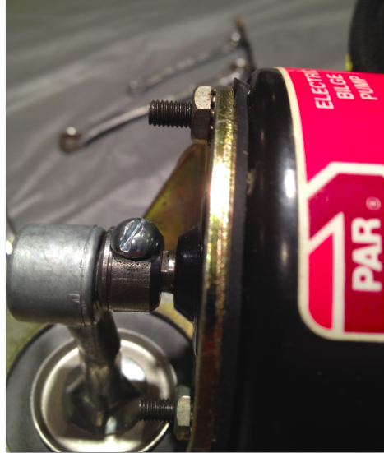
Re-assemble Motor to Motor Mount
Make sure you had the parts in the right orientation
Motor is supported in a level position so that I get a level, straight connections
Attach Motor to Mount with the two nuts
I place a small drop of “blue” Thread locker on the bolt threads
Tighten nuts in equal turns until tight
Re-assemble Connecting Rod to Motor shaft
Slide the Connecting Rod unto the Motor shaft
Tighten the set screw onto the flat surface of the motor shaft
I did not apply Thread locker on the screw

Slide 13
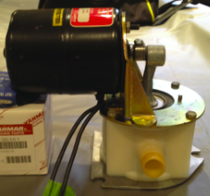
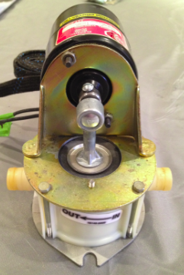
Re-assemble Base to Motor Mount
Make sure you had the parts in the right orientation, unit is supported in a level position to get a level, straight connections
Side the two back bolts through the Motor Mount first
Then side the Base under the Motor Mount and slide in the front screws
The put the bolts into the mount just one or two turns. This ensures the bolt are all connected
I place a small drop of “blue” Thread locker on the bolt threads. Do not put the thread locker on the plastic
I tighten the bolt in equal tension, like one turn each in a cross tightening rotation
Unit is ready to be tested and then back on the boat

